Slide 1
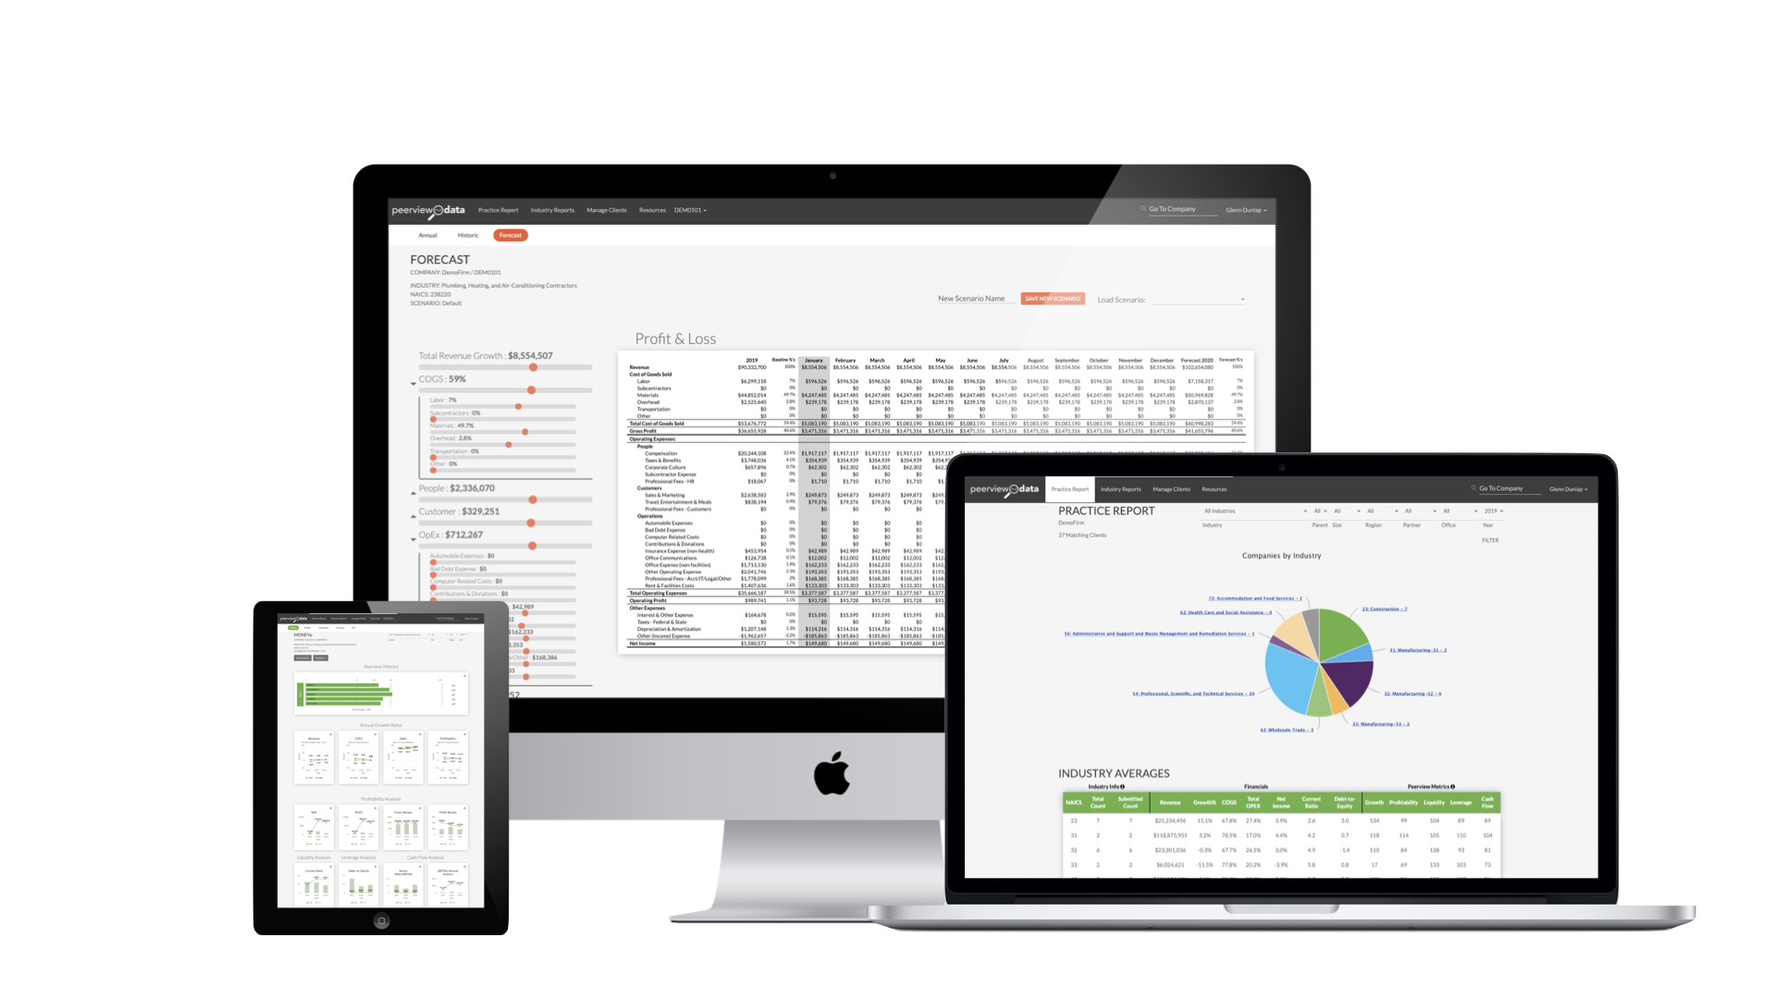
Becoming a Consultative Advisor
Welcome!

Slide 2
About Peerview Data
Peerview Data’s cloud-based analytics and advisory platform uses the data CPA firms already collect, factors in proprietary insights as well as trend & market KPI's, and turns it into competitive insights CPAs and advisors can use to improve their clients’ performance.

Slide 3
About Our Speaker
Founder and CEO, Peerview Data
Co-founder of accounting and advisory firm, Milestone Advisors
Founder of Big League Tours
Presenter: Glenn Dunlap
Connect on LinkedIn: https://www.linkedin.com/in/glenn-dunlap-79b5763/

Slide 4
Learning Objectives
Recognize how you can serve clients at a deeper level by becoming more consultative
Identify specific conversation starters to open the door for a broader conversation about business performance
Discover tools to help guide these conversations, such as Peerview Data's Company Reports, Practice Reports, and Summaries and Forecast Tools
Understand how future-focused discussions can help your clients improve their operating performance
Learn how other CPAs and advisors are pricing additional services

Slide 5
Answering the “Why”?
“People don’t buy what you do; they buy why you do it.”
Simon Sinek

Slide 6
Answering the “Why”?
Why Become a Consultative Advisor?
To serve the needs of your clients.

Slide 7
Blocking the Time
Schedule driven by clients and deadlines
You have to be available when clients need you
Better yet is reaching out before they know they need you
Won’t happen if you’re booked solid.
Need to develop a plan that’s right for you – how much time to set aside, how to use it, with whom, etc., and then work the plan
Notes:
Schedule is often dictated by clients and by deadlines
But, you have to be available when clients need you
Moreover, you’re going to need to proactively reach out to your clients.
Won’t happen if you’re booked solid.
Need to develop a plan that’s right for you – how much time to set aside, how to use it, with whom, etc., and then work the plan

Slide 8
Asking Great Questions
Business owners can be the worst at opening up.
Public vs. private – switch can be tough
It’s going to take some great questions & active listening to get things started on the right track
Notes:
Business owners can be the worst at opening up.
Constantly putting on public-face and telling everyone how great everything is. (Really busy. Great opportunities. Things are going well. Blah blah)
Meanwhile, worried about payroll, the bank loan, the investor deal, the customer proposals, delivering products/services, PPP, PPE, and on and on…
It’s hard to let your guard down and be candid about what’s going on.
It’s going to take some great questions & listening to the answers

Slide 9
Asking Great Questions
“The smart ones ask when they don’t know. And, sometimes, when they do.”
Malcolm Forbes

Slide 10
Asking Great Questions
Ice breaker questions:
What have you been working on?
What would you like to be working on?
Who (on your team) is kicking butt and taking names?
Best and worst thing that happened last week?
Notes:
The 4 C Questions are Context, Causal, Challenge and Calibration

Slide 11
Asking Great Questions
Open-ended questions:
What are some of the larger initiatives your team is working on?
What opportunities are you most excited about for the coming months?
What concerns you most about the next 90 days?
What surprised you most over the last month?
https://convergencecoaching.com/the-power-is-in-the-ask/
Notes:
The 4 C Questions are Context, Causal, Challenge and Calibration
Liz Notes: Some of these questions seem a but more manager/staff performance related, than CPA/client business performance…
Ideas for business questions:
What are some of the larger initiatives your team is working on?
What opportunities are you most excited about for the coming months?
What concerns you most about the next 90 days?
What surprised you most over the last month?

Slide 12
Questions & Answers
What are your favorite questions to ask clients?
Notes:
Liz note: We’ll use the Questions box for this interaction – Great question to ask the audience!!

Slide 13
Questions & Answers
Often, the initial answers won’t really tell you what’s going on. So, you’ll need to listen carefully and ask multiple follow up questions.
“Lower sales? Tell me about that?”
“Missed deadline? What happened?”
And more follow-ups:
“How will this impact performance?”
“What needs to be done to ensure this won’t happen again?”
“What’s the plan to fix this?”
“Where do you need help?”
Notes:
Liz note: Some of these questions seem more manager/staff related than CPA/client…

Slide 14
Speak Truth
How many times have you held something back because you were unsure how it would be received?
You have to be willing to address the difficult things that you see.
Let the numbers tell the story, avoid making things personal, & stick to solving the problem at hand
Notes:
All truth and no love is brutality. All love and no truth is hypocrisy.

Slide 15
Preparing for Meetings
Don’t wing it or come into a session fishing for ways to help.
You have their numbers. Dig into them.
Generate ideas, questions, suggestions ready to enable meaningful change

Slide 16
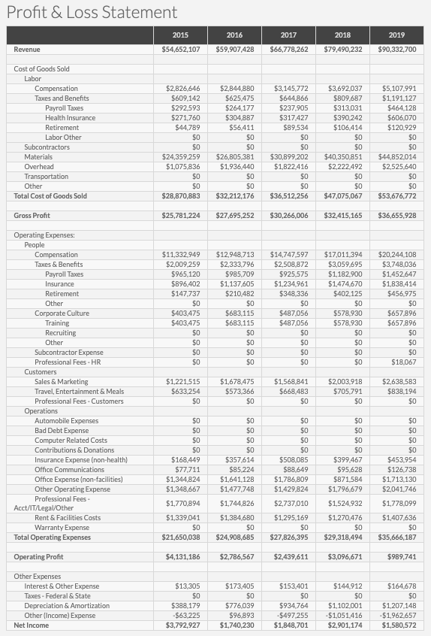
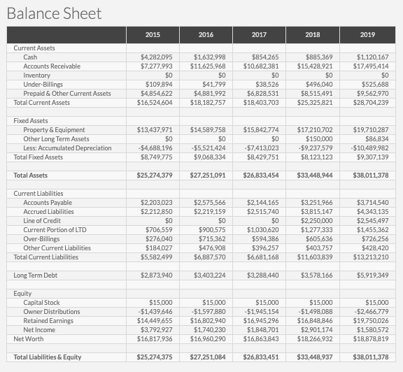
Financial Statement Analysis
Notes:
Dem0117
Revenue growth
Fixed assets
A/R
Inventory
Dem0101
Revenue growth – sustainable? Driving?
Margin difference - People costs above vs. below
A/R
Inventory

Slide 17
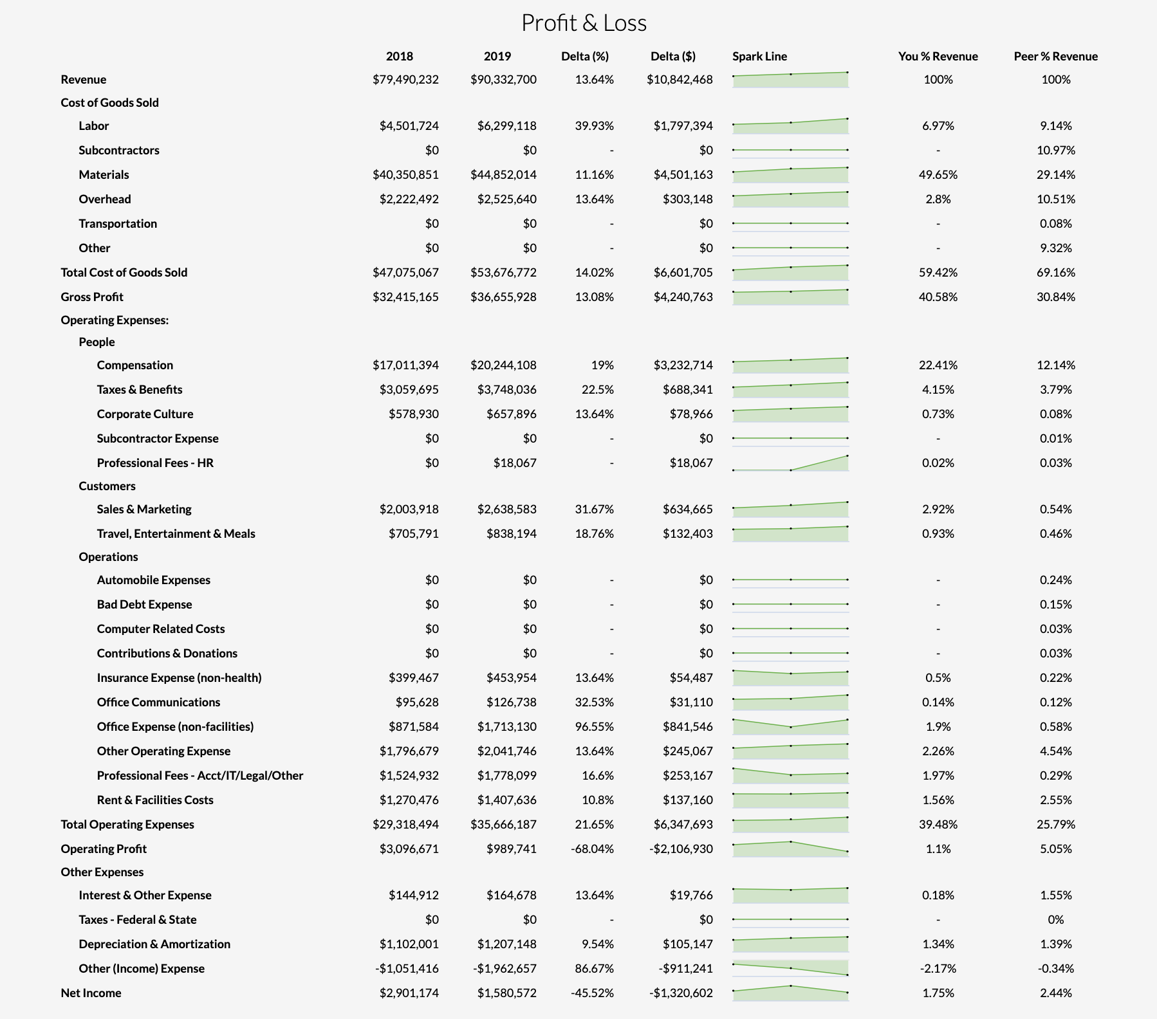
Industry Examples - Construction
Notes:
Liz note: As you go through these industry examples, will you be talking about them in a case study formatting highlighting client examples? Tying in how these tools have helped CPAs’ clients improve their operating performance would be perfect!

Slide 18
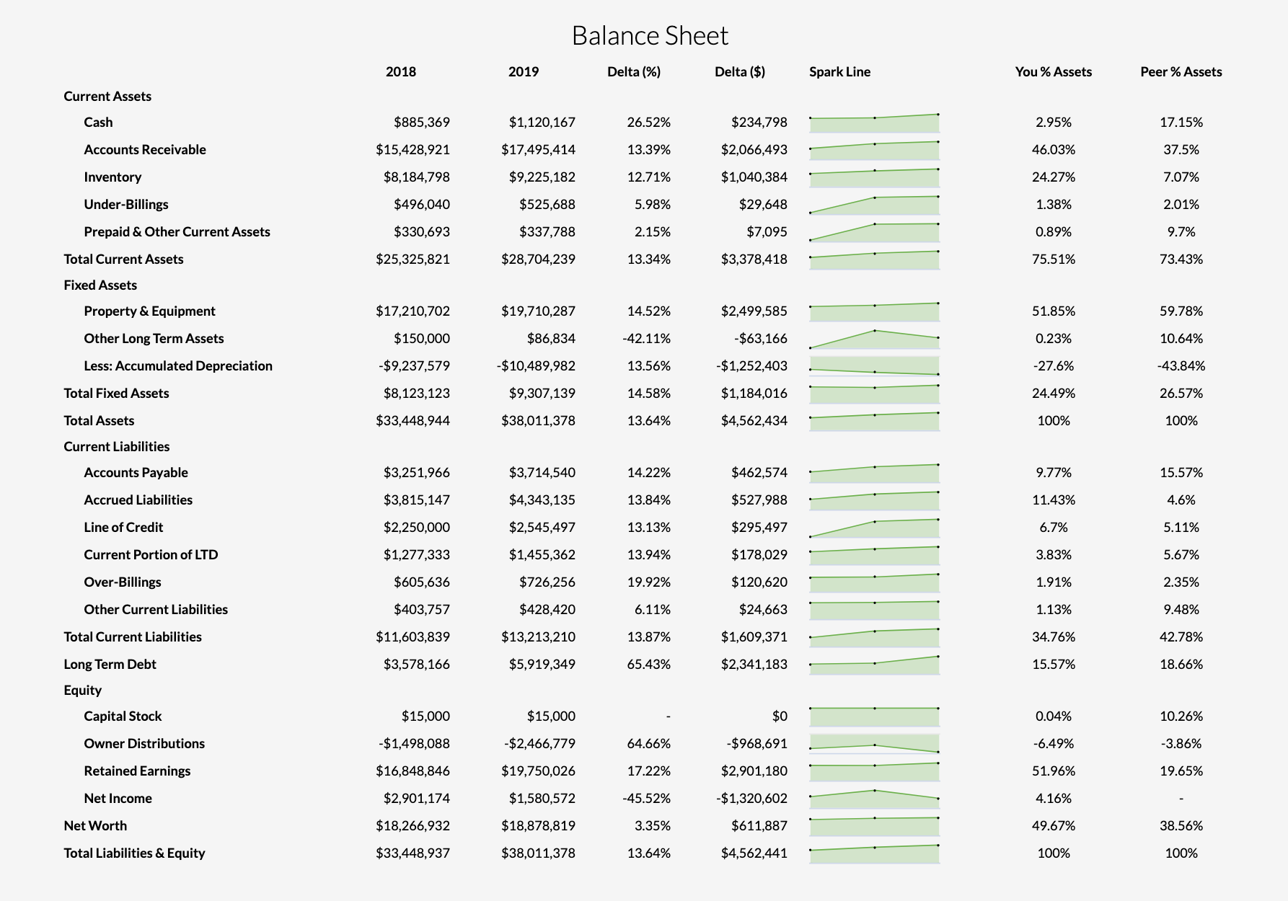
Industry Examples - Construction

Slide 19
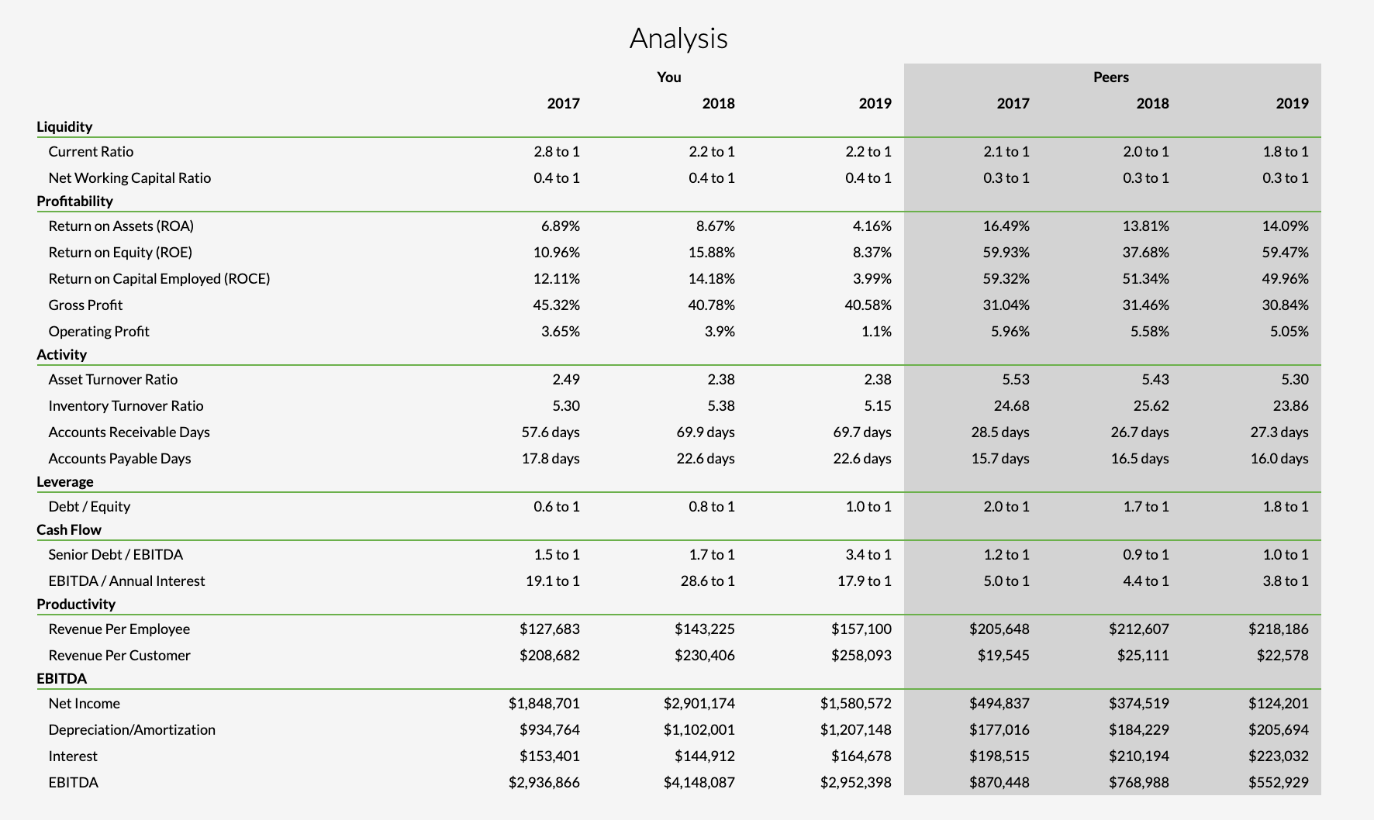
Industry Examples - Construction

Slide 20
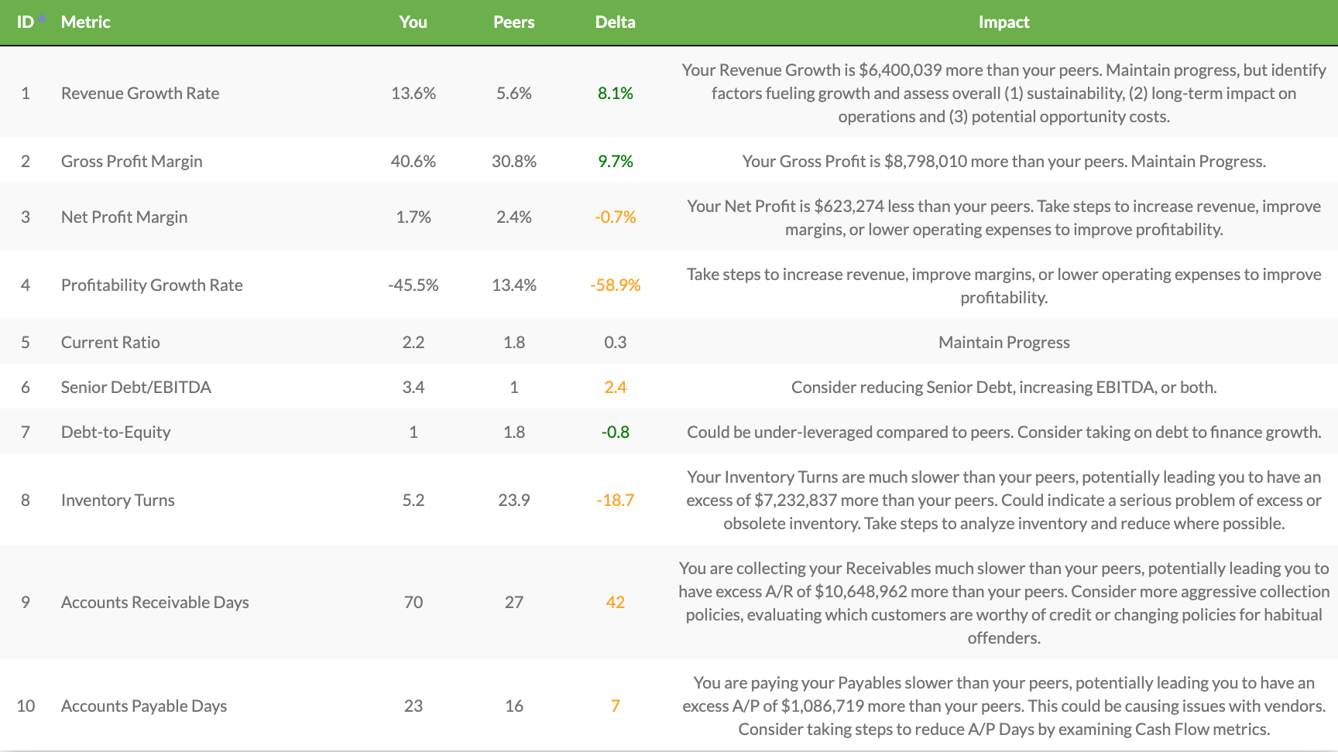
Industry Examples - Construction

Slide 21
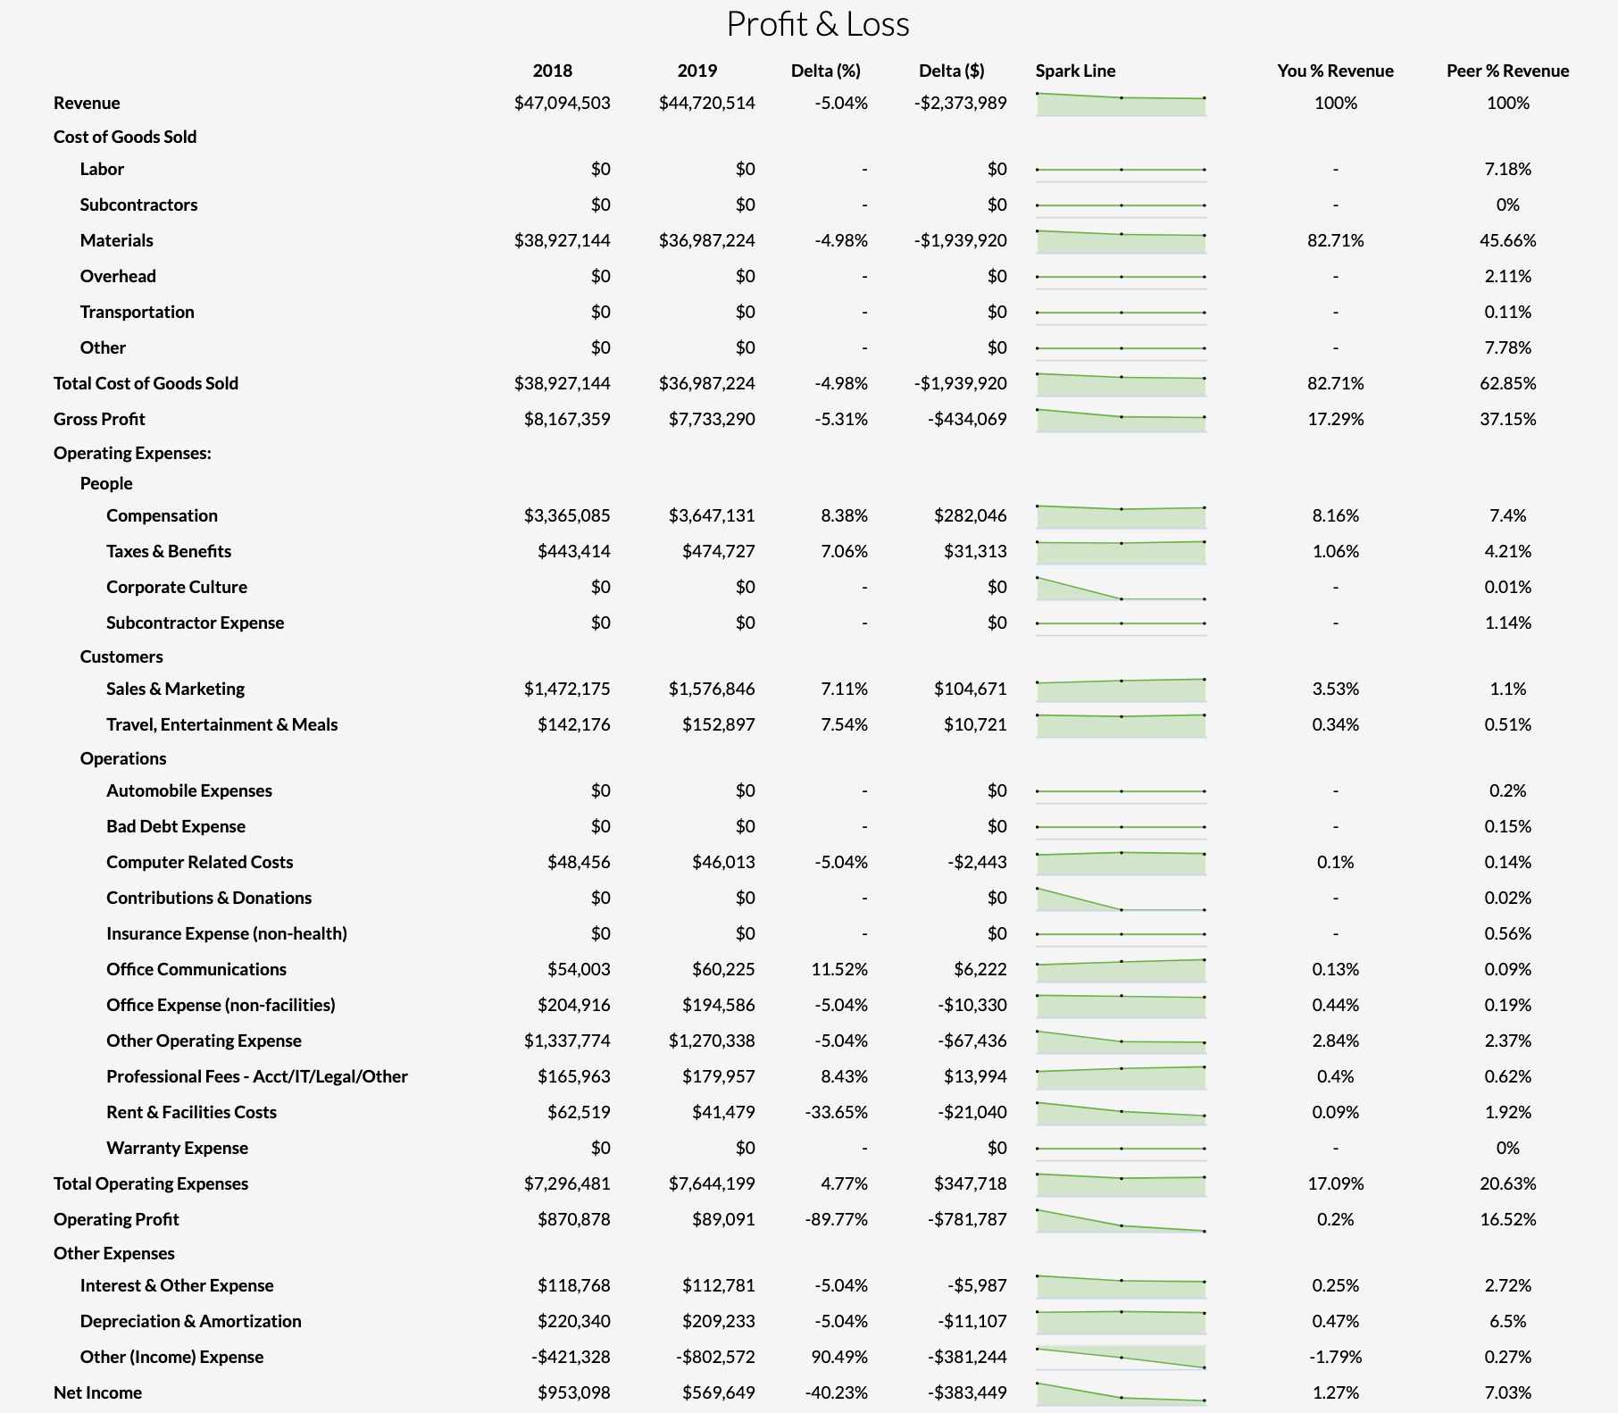
Industry Examples - Manufacturing

Slide 22
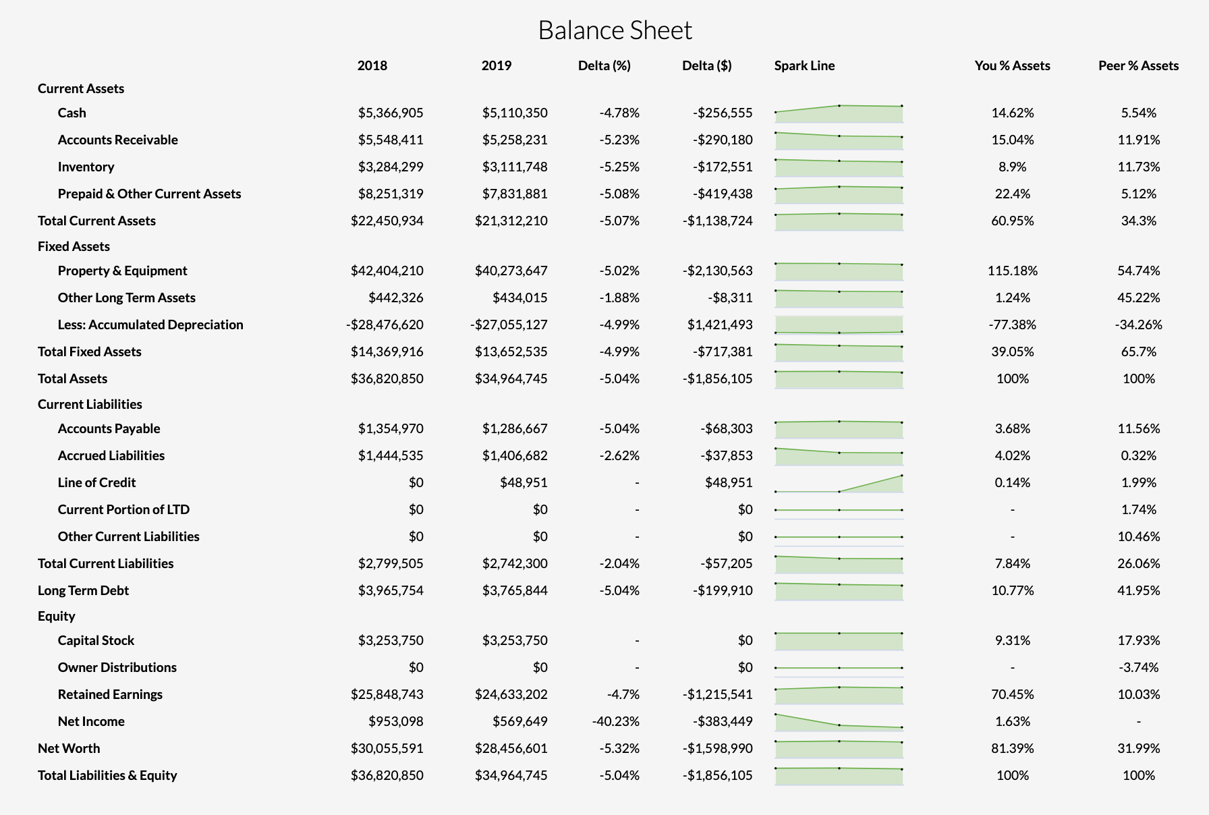
Industry Examples - Manufacturing

Slide 23
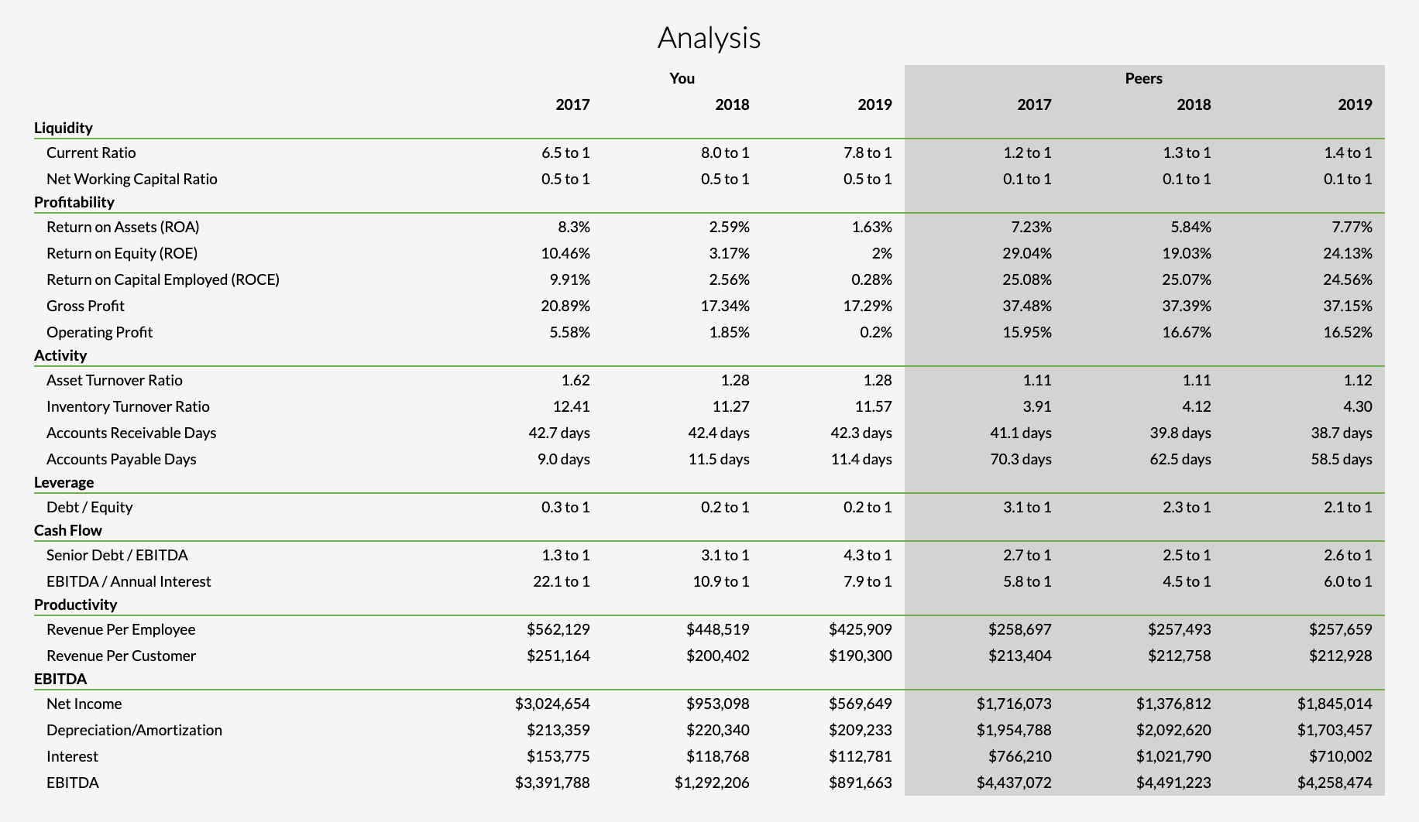
Industry Examples - Manufacturing

Slide 24
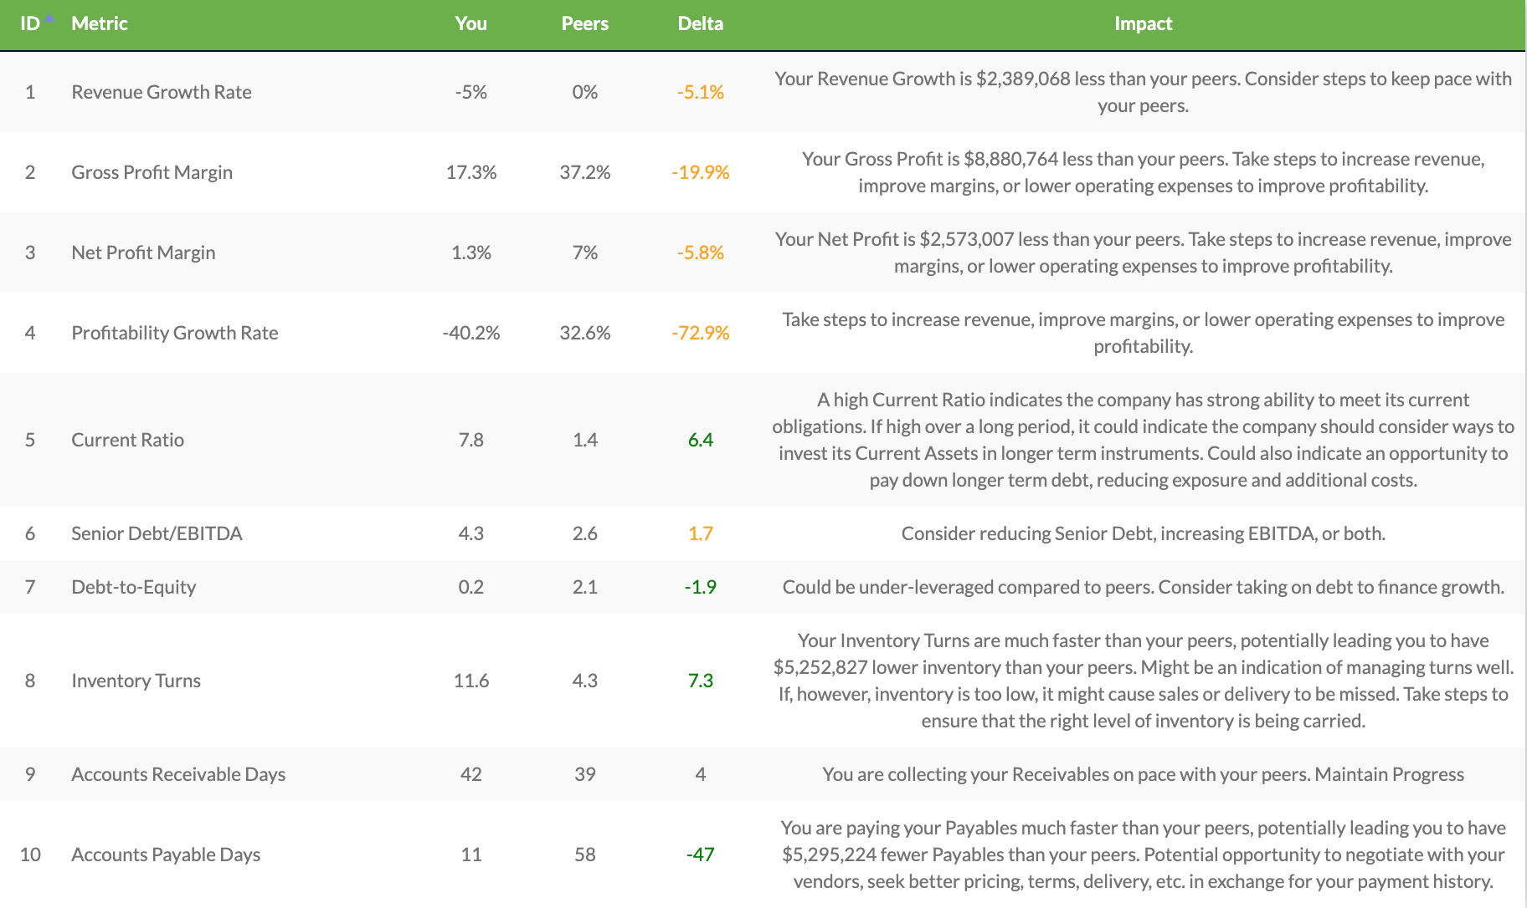
Industry Examples - Manufacturing

Slide 25
Live Examples

Slide 26
Pricing
Coming in prepped with analysis and deliverables increases the likelihood that your time will be billable
We see firms charge hourly for the prep time & meeting or sometimes they’ll charge a package rate
Rates and structure vary based on size & type of firm, who is delivering the work, etc., but we often hear $500-$1,000 for the analysis and initial prep
We would also expect that you’ll pick up a project or two as a result of the meeting, which becomes billable revenue, too.
Notes:
Liz’s note: I imagine setting the expectations up front with the client re: fees is most important (do you see CPAs offering the first consultation for free, and asking if the conversation is something the client would like to add on a monthly or quarterly basis?)
What types of projects do you hear that Peerview’s clients are picking up?

Slide 27
Special Offer
Signup Today for a Free Trial Account
30 days free
Run up to 5 companies
Full access to every report
Connect to QBO
No CC required
http://www.peerviewdata.com/free_trial_account
Notes:
Offer:
Free trial account
Choose your type: CPA firm or Operating company
30 days free
No CC required

Slide 28
Contact Info
Glenn Dunlap
Founder + CEO
Peerview Data, Inc.
525 S Meridian St, Suite 1E11
Indianapolis, IN 46259
glenn.dunlap@peerviewdata.com
317.507.3499

Slide 29
Thank you!

